Slide 1
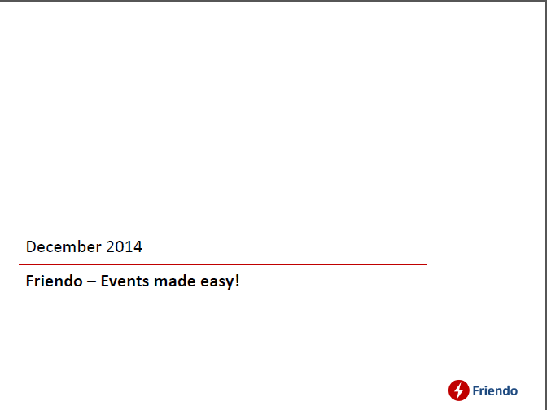

Slide 2
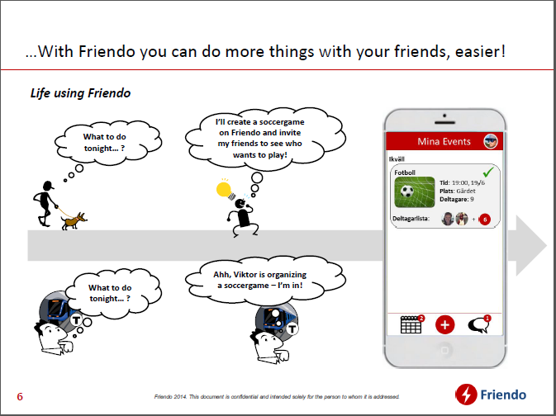
My Events

Slide 3
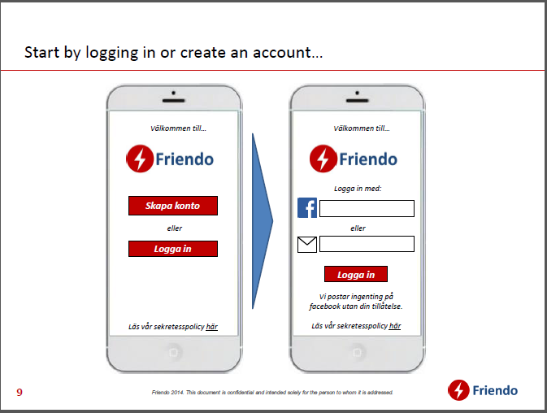
Welcome to...
Welcome to...
Log-in wih...
New Account
Or...
Or...
Log-in
Log-in

Slide 4
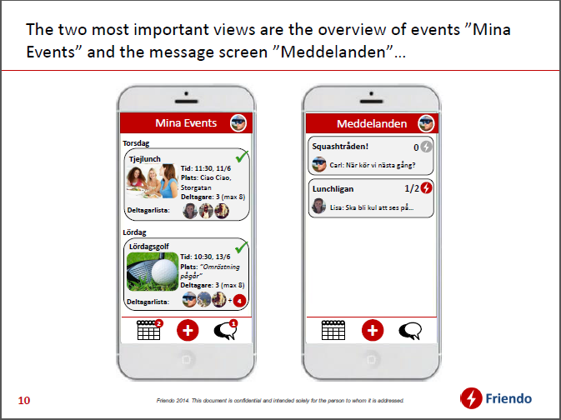
My Events
Messages
Thursday
Squash thread
Girls' Lunch
Carl: When do we play next ime?
Time:
Place:
Paricipants:
The Lunch Leage
Who is coming::
Lisa: Will be great seeing you on...
Saturday
Time:
Place:
Participants:
Who is coming::

Slide 5
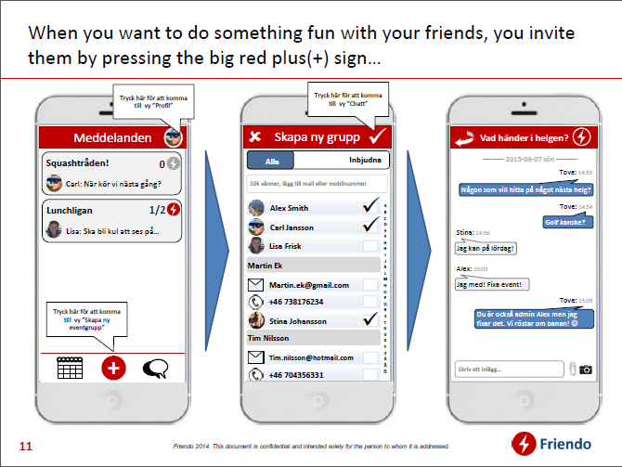
Click here for “profile”
Click here for
“Chat”
Click here for “profile”
Click here for “profile”
Messages
Create New Group
Weekend Events
Squash thread
Carl: When do we play next ime?
The Lunch Leage
Lisa: Will be great seeing you on...
Click here for
“Create new
event group”

Slide 6
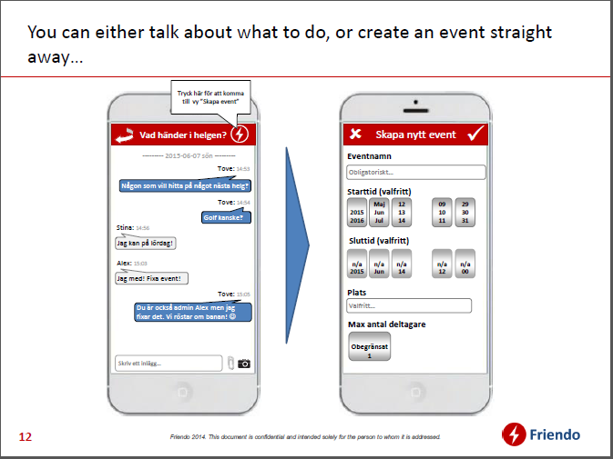
Create Event button inside ChatGroup
Weekend Events
Create New Event
Create New Event
Event name
Event starts
Event ends
Event location
Max. number of participants

Slide 7
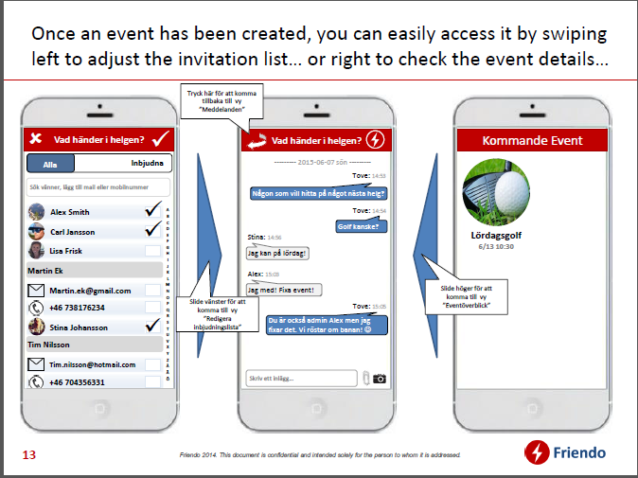
Weekend Events
Weekend Events
Upcoming Events
Saturday Golf

Slide 8
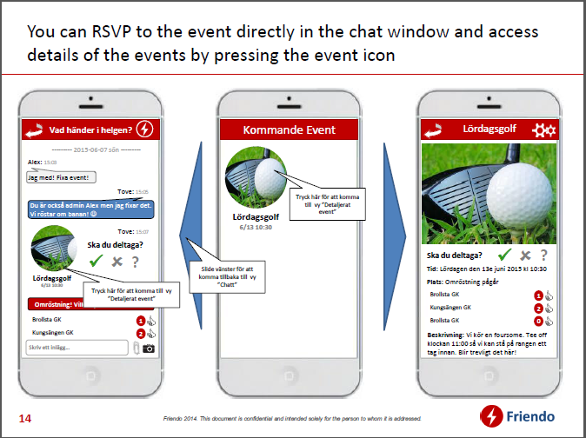
Weekend Events
Upcoming Events
Saturday Golf
Saturday golf
Participarting?
Participarting?
Saturday golf

Slide 9
